Slide 1
Final Project: chatbot
By Szőllősi szilárd-Árpád

Slide 2
Content
Goals
The data
The Chatbot
Conclusion

Slide 3
Goals
The main objective of the project was to use the provided data , and create a model , using the sklearn and tensorflow python libraries , for a chatbot that can help a hospital during peak hours.

Slide 4
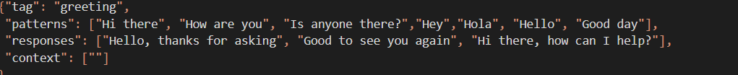
The Data
The data for this project was provided in a JSON file , containing data with 14 different tags . The tags of the data help the model associate the questions with a type of answer that it needs to pick. In the code snippet , we can see an example of the data from the JSON file , that helps our model to identify greetings:

Slide 5
The chatbot
In order to create the chatbot I have used sklearn and tensorflow to create the model. This model is using deep-learning in order to understand what we are trying to tell , and generate a response.
Deep learning uses “neurons” that are trying to replicate the way the human brain works thus the name “neuron”. The number of neurons can be defined by us , and also the “activation mode” of the neurons can be defined by us in order to introduce non-linearity into the model.

Slide 6
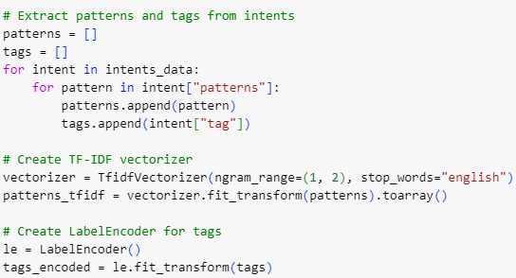
The chatbot
First we need to process our data , so I have vectorized them , so that the model can understand the data and create patterns.
The model can’t process categorical data so I have had to encode that too.

Slide 7
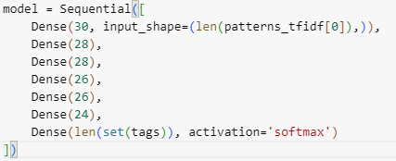
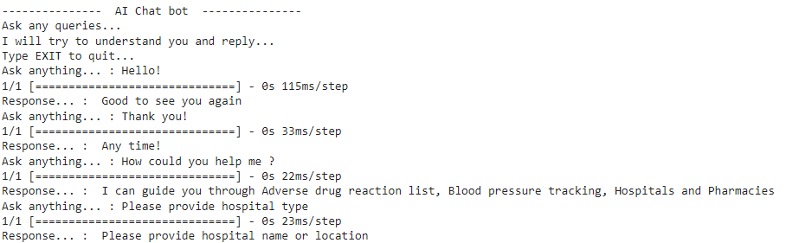
The chatbot
After I have made different models , that have used different neuron structures.
On the right you can see the fitst model , which is quite simple , it uses an input and an output neuron layer , and multiple layers between them. This is how the resulting chatbot worked:

Slide 8
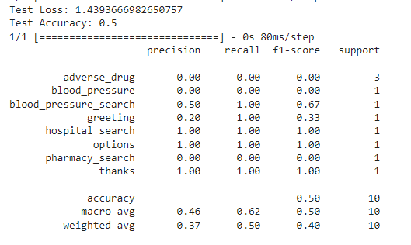
The chatbot
I have tried to create better models using hyper-parameter tuning.
The first step was to try and create a more complex neural model , which should help our model understand better the more complex patterns:

Slide 9
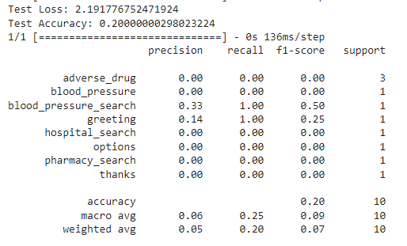
The Chatbot
After that I have tried to increase the performance using dropout layers to introduce regularization, however the results did not improve:
Following this I have tried to use more epochs , so that the model would be trained more , however I still couldn’t achieve much better results , than with the untuned versions.

Slide 10
Conclusion
In conclusion, the project successfully developed a chatbot using a neural network architecture trained on a dataset of intents. Through the implementation of TF-IDF vectorization, Label Encoding, and a multilayer perceptron model, the chatbot demonstrates the ability to understand and respond to user queries effectively. Further improvements could involve fine-tuning hyperparameters, exploring different neural network architectures, and expanding the dataset to enhance the chatbot's performance and versatility in real-world applications.

Slide 11
Thank you!
https://github.com/SzSzilard03/FinalProject - project source

